Slide 1
s
2026年10月13日
OpenAI vs. Mathematicians: The Question Behind 700 Papers
房煦博（ボウ クハク）bou kuhaku

Slide 2
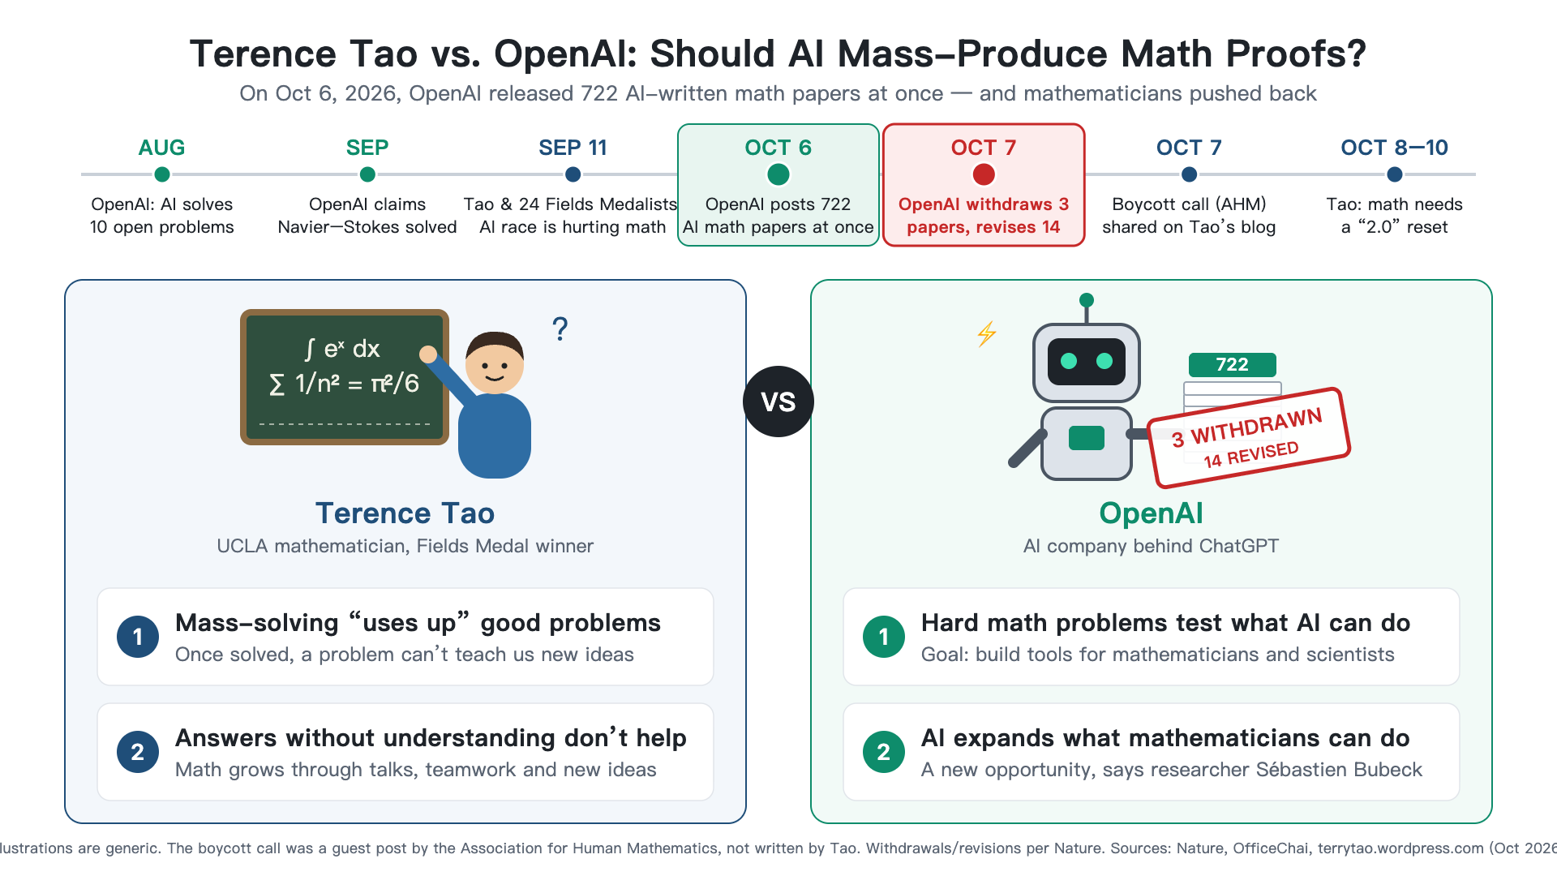
01
What Happened?

Slide 3
01
My opionion
AI: A Teacher for Everyone
✅ Good #1 — Helps Engineers
Before: reading logs line by line for hours
Now: AI gives new ideas and directions → saves time
✅ Good #2 — Helps Learners
Hard subjects: electromagnetics, signals, probability
Statistics teaches us to see hidden risks
"I wasn't unable to learn. I just didn't have a teacher."
❌ Bad — Publishing Without Checking
The problem is not AI. It's humans not checking
Agree with Tao: this release was a bad idea
Disagree: we should not stay away from AI

Slide 4
01
A Different Approach: Anthropic
Their Goal
Computer checking can reduce the burden on human reviewers
Make math "easier, not harder, to trust"
OpenAI vs. Anthropic
 | OpenAI | Anthropic
Style | Hundreds of papers at once | Work with human mathematicians
Checking | ~42% checked | Fully checked by computer
Focus | Speed & scale | Trust

Slide 5
01
What Do You Think?
Should we ride the AI wave, or slow down?
My answer: Ride it — but with human checking.

